Slide 1


Automatic segmentation of left ventricle
MEDICAL IMAGE ANALYSIS
A Project under the guidance of
Prof. Alain Lalande
Francois LEGRAND
Olivier AGBOHOUI
Hardiksinh PARMAR

Slide 2
Introduction
Perform epicardial and endocardial left ventricle segmentation.
Use a publication as frame basis for implementation
Study a concrete use of advanced image processing technics
Reinforce programming skills

Slide 3
Summary
Three main parts
1 - Context and frame of the project
2 – MATLAB Left Ventricle segmentation
3 – C++ Left Ventricle segmentation

Slide 4

I - Context and frame of the project
Project inspired by MICCAI conference
Available Dataset AC/DC

Slide 5
II - MATLAB Left Ventricle segmentation
Originally based on previous work by M.P. JOLLY .et al (2009)
Uses “standard” image segmentation methods
Targets left ventricle Endocardium and Epicardium boundaries
Works automatically, almost no user action

Slide 6
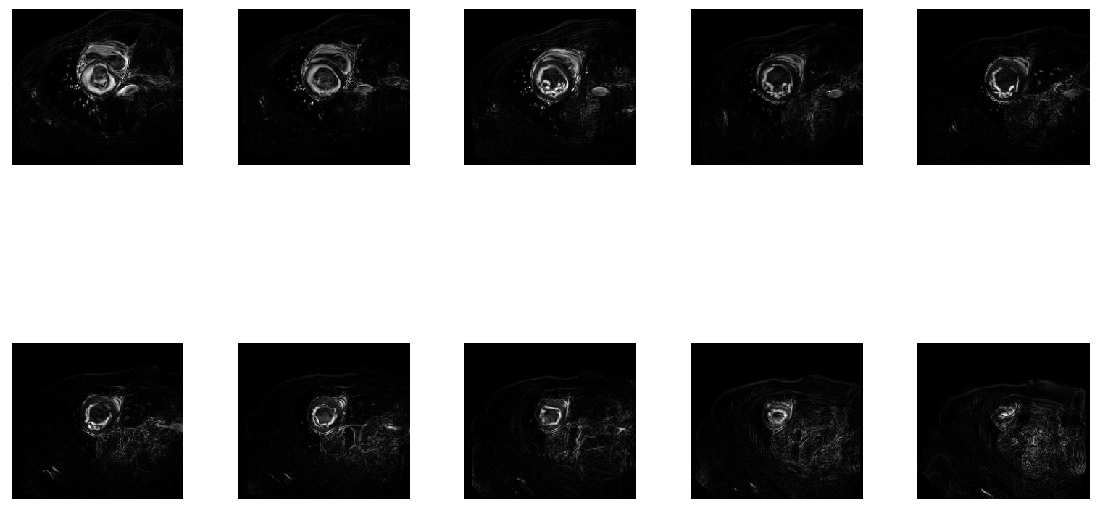
II - MATLAB Left Ventricle segmentation
Uses Fourier Transform to extract moving area

Slide 7
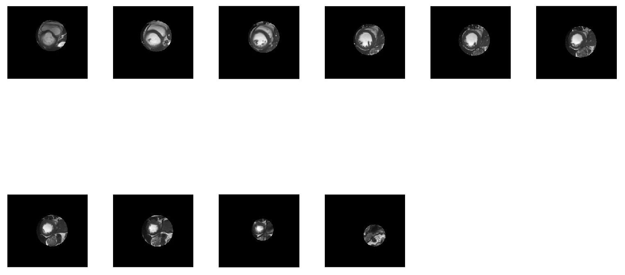
II - MATLAB Left Ventricle segmentation
Region of interest using Weighted Centroids

Slide 8
II - MATLAB Left Ventricle segmentation
ROI refinement using snake contouring
Cartesian to polar coordinate to remove zeros values
Minimum and maximum value padding
Otsu’s histogram thresholding

Slide 9
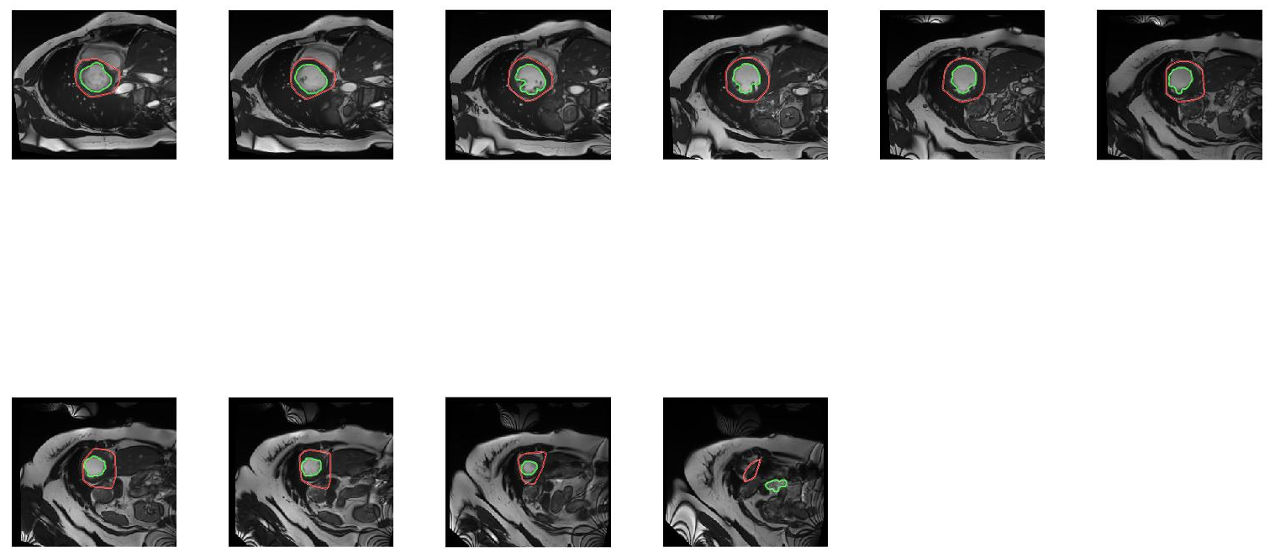
II - MATLAB Left Ventricle segmentation
Morphological operation and shape extraction for segmentation

Slide 10
DEMO

Slide 11
III - C++ Left Ventricle segmentation

